Slide 1
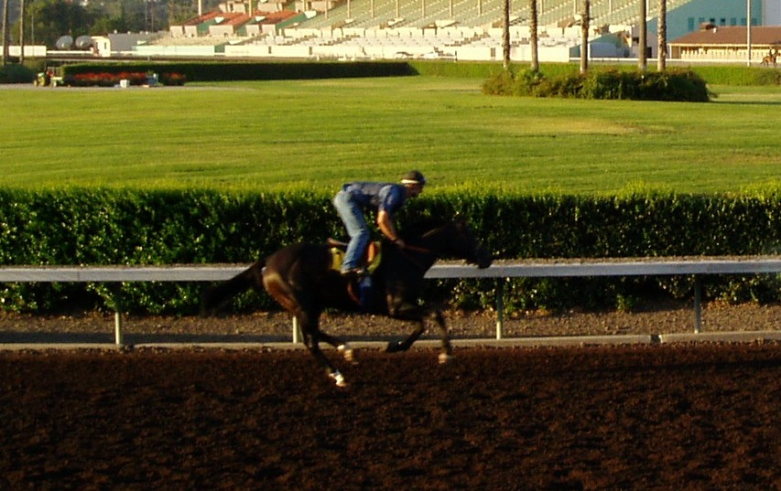
Synthetic vs. Dirt –
A Track Superintendent's Viewpoint Forum – Salon A
View from the surface

Slide 2
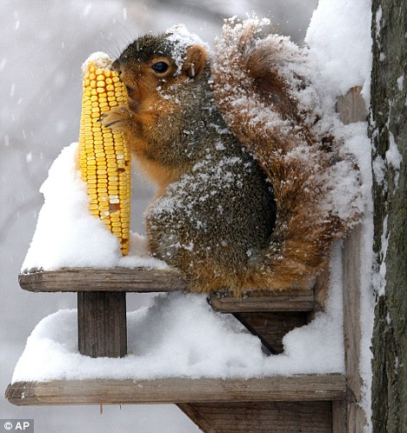
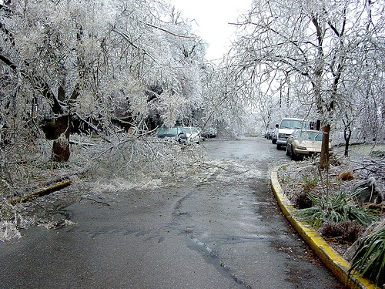
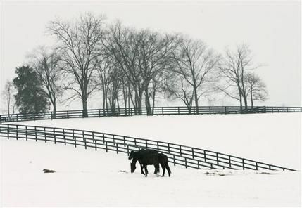
Being a Track Man Isn’t Easy…
Mike Young had to cancel
The view from Kentucky
But he is working at Keeneland

Slide 3
Our Panel
Joe King
Irwin Driedger
Dr. Selway

Slide 4
What makes a Track Succeed?
1) Independent of material, some tracks seem to succeed. We have clear successes on dirt, and we have some clear successes with synthetics. What are the big factors that make the difference.

Slide 5
Differences in Europe
2) Has the experience in Europe with synthetics gave a false impression of their effectiveness. How important is the way we use the surfaces to their performance. Keeneland is used year around. The traffic at Woodbine on almost any day is incredible traffic Do you think this matters?

Slide 6
Weather
3) Tell me how you deal with weather. The issues are different for dirt and synthetics but every track seems to have issues. What is the toughest situation to deal with at your tracks, and is this a major issue in track design.

Slide 7
Keeping Track
4) What methods are you currently using to monitor the performance and test the material in your tracks? Do you see a day when there is a measurement which can help a horseman to be confident that the track is safe, and we can quit talking so much about tracks?

Slide 8


Surfaces
Standardized Tests,
Engineering Support &
National Laboratory
      Michael “Mick” Peterson PhD
      University of Maine
      C. Wayne McIlwraith DVM, PhD
      Colorado State University

Slide 9
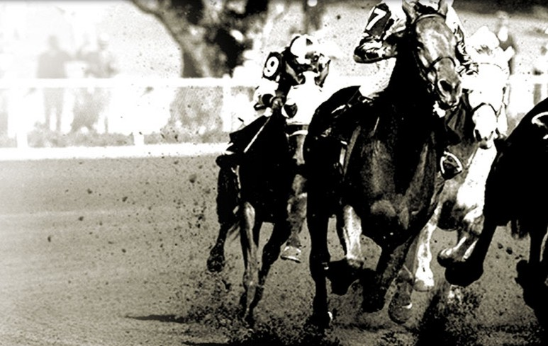
Recommendations of:
The Welfare and Safety of the Racehorse Summit
Keeneland Sales Pavilion
Lexington, Kentucky
March 17-18, 2008
RECOMMENDATION 1:
TRACK SURFACES
Primary Objective:
Promote consistent and
safe track surfaces conditions

Slide 10
What is Needed?
Clearinghouse for surfaces data
  Reliable & consistent testing
  Risk assessment data
  Sharing of methods
Understand regional needs
Create a culture of data

Slide 11
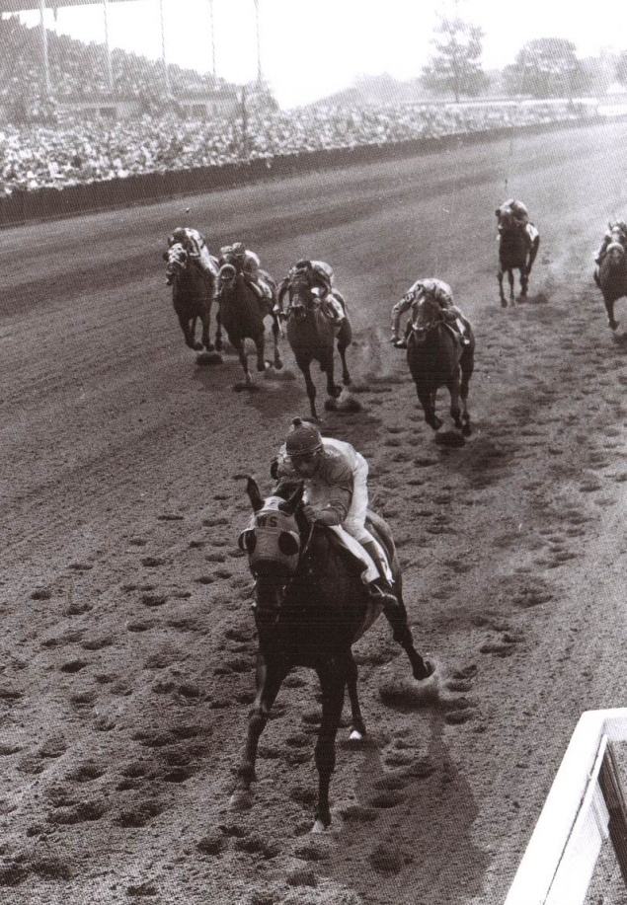
Practice Not Research
Track Materials – Synthetic & Natural
  Non-linear
  More load
  the harder
  Strain rate dependent
    Synthetic creep
    Dirt shows dynamic
    softening
Not easy or standard tests

Slide 12
Consistent Track Composition
Consistent test methods
New methods when needed
Database of results for
research
Open to all users:
Non-proprietary methods
A Single Reliable Lab for the Industry

Slide 13
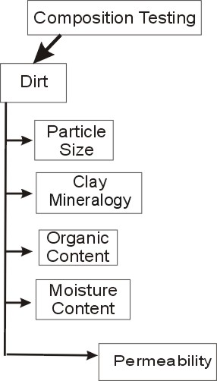
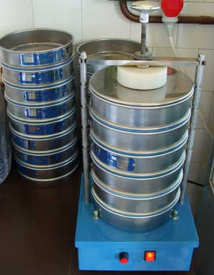
Measurement Methods:
Dirt Composition
Many tests for dirt established
  Need comparative data
  Not repeatable between labs
Clay mineralogy
(X-Ray Diffraction)
Fiber weight percentage

Slide 14
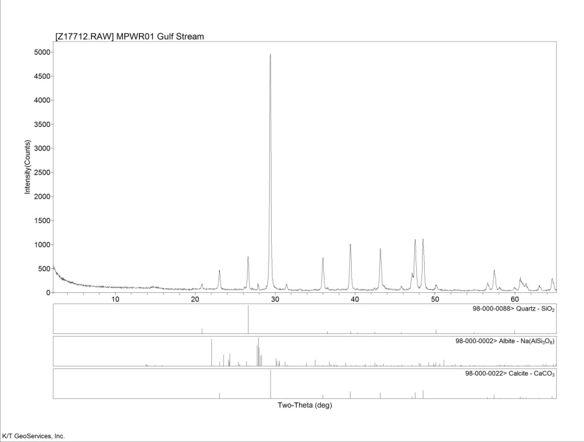
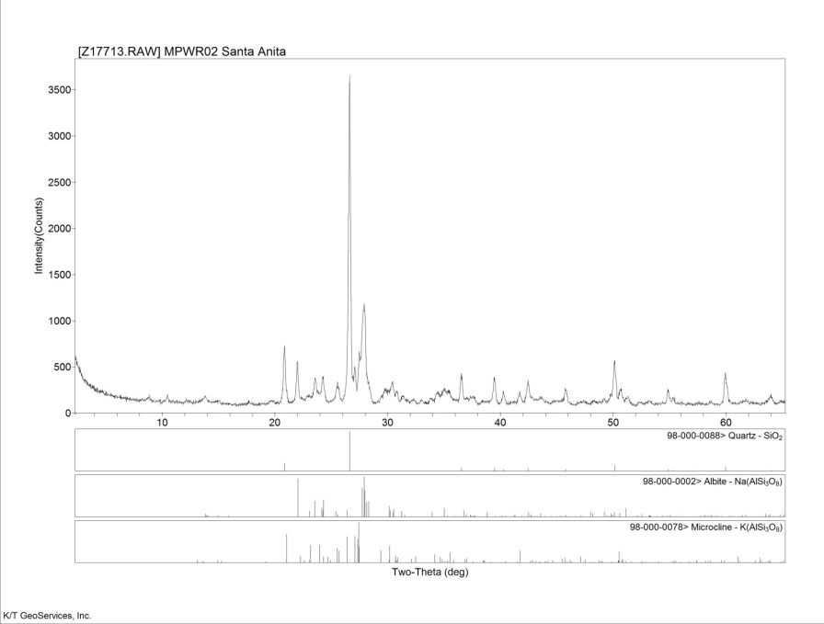
Implementation:
X-Ray Diff. (XRD)
Clay mineralogy
  “East Coast” vs.
  “California”
  “No” clay in most
  east coast tracks
Small or
missing peaks

Slide 15
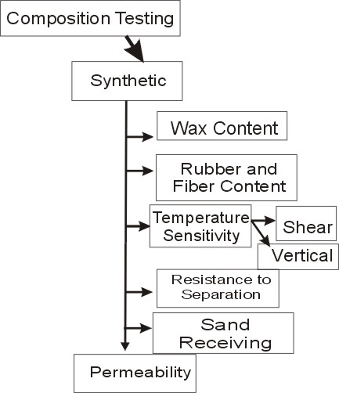
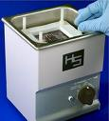
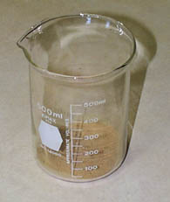
Measurement Methods:
Synthetic Composition
Wax composition
Temperature sensitivity
New
Funding

Slide 16
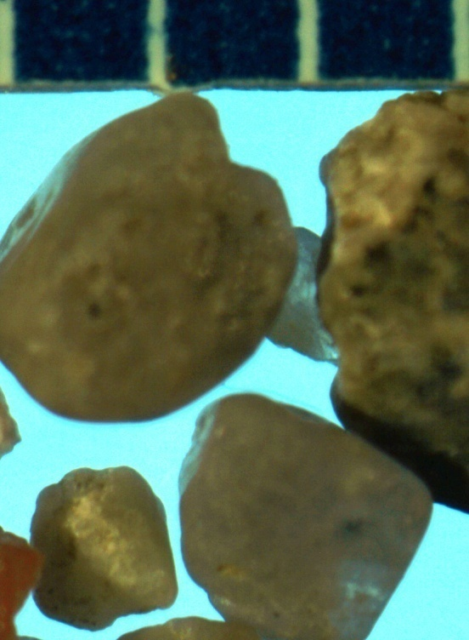
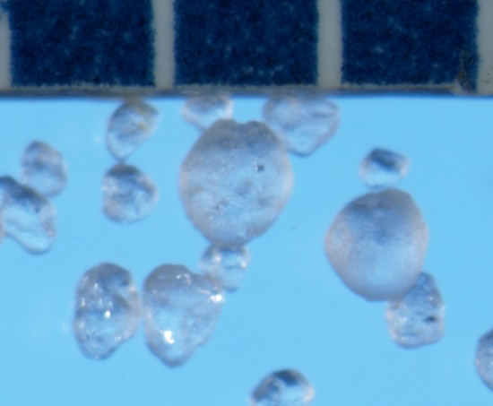
Implementation:
Quality Control of Materials
Sand Matters…even in synthetic surfaces
  Microscopy
  XRD Mineralogy

Slide 17
Implementation: Wax DSC
Added wax
High temperature
wax used initially
New wax reduces temperature sensitivity at critical 100-125°F

Slide 18
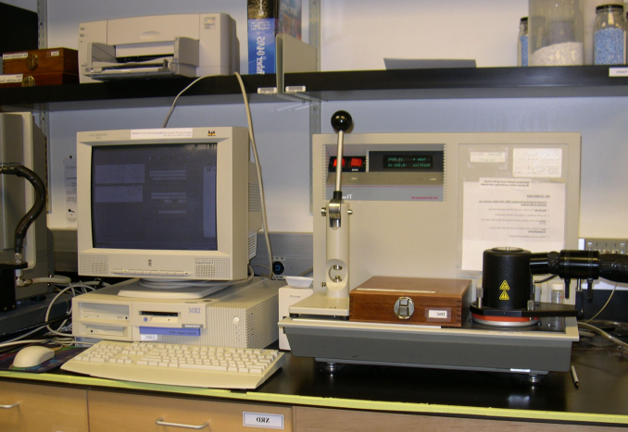
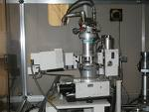
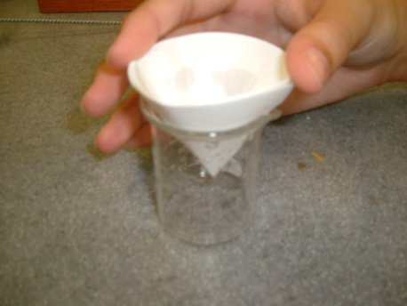
Laboratory for
Analysis of Track Materials
A central lab to compare between tracks
  Consistent data
    Current labs:
    agriculture
    civil engineering
  Data for research
Link to injury database
Developing new tests of materials
Coordinating high cost specialized testing XRD, DSC

Slide 19
Central Track Surfaces Lab
Modeled on drug testing labs:
But this is on the ground floor
National facility:
Regional duplication only if needed
Initial seed money:
  Capital costs
  Initial labor, training and “certification”
Continuing funding
  Initial investors, forms part of the board to determine research priorities
  Tracks subscribe, standard package
  Pay per test on added materials and as needed

Slide 20
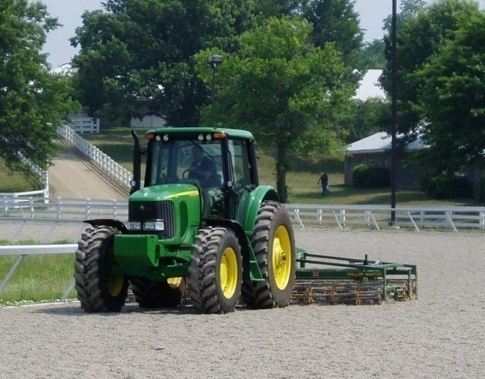
Maintenance Matters
Different tracks do things differently
Justified reasons
  Weather
  Design
  Usage
Develop best practices

Slide 21
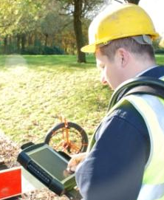
Maintenance & Condition
Reporting System
Start simple,
research leads to expansion…
The model – start simple
On-Track Injury
…catastrophic,
then expand
Jeff Blea & Wayne McIlwraith
… other injuries

Slide 22
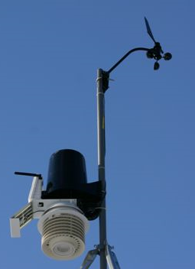
Maintenance & Condition
Reporting System
Weather data logging
  Data logger for at standard location
  Temperature, humidity,
  precipitation, wind, UV
  & visible light, evaporation
  rate and track temperatures
Linked to maintenance
reporting database
(and handicapping?)

Slide 23
Performance Testing
The perfect surface needs to perform in the real world
  Temperature
  Moisture
  Maintenance
Performance of the
surface
  Shear strength
  Stiffness
Performance
Testing

Slide 24
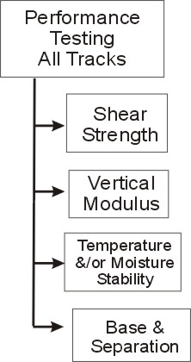
Performance testing…
On-site performance monitoring
  Research must show that the measures relate to safety of the horse
  Daily measurement of performance
  Periodic measurement of composition
Do the research and determine which factors pose a risk

Slide 25
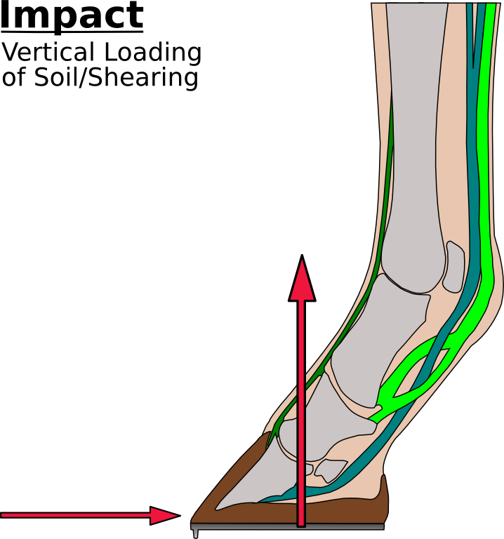
Surface has different function during phases of gait: Impact/loading
Lower vertical modulus reduces strain rate
and peak loads
Shear failure reduces horizontal peak accelerations

Slide 26
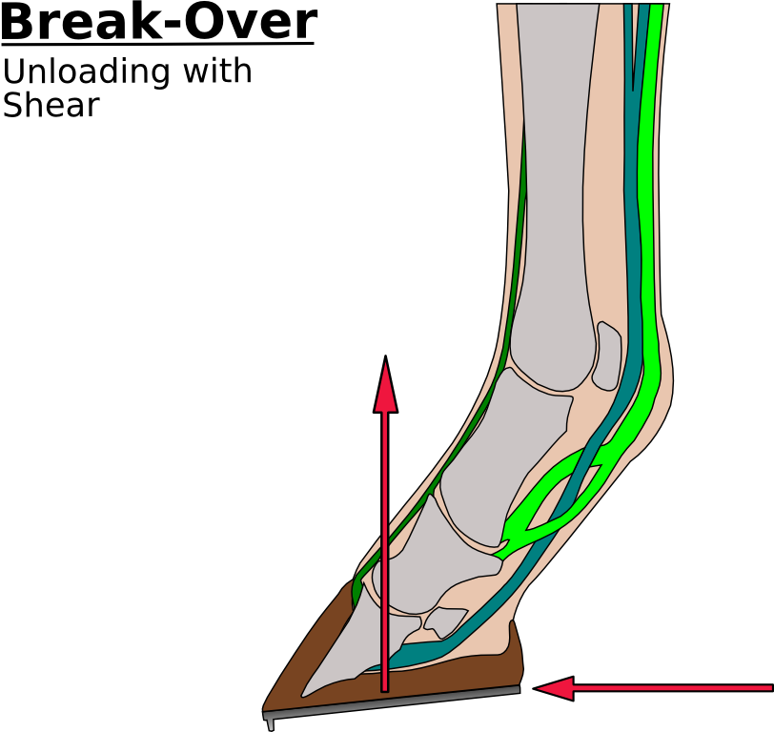
Surface has different function :
Breakover/Propulsion
Shear strength to support hoof during propulsion
Control hoof rotation during turn
http://www.wyammyranch.com/horses/sangria.jpg

Slide 27
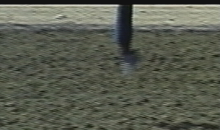

Biomechanical Hoof Tester
Biomechanical Hoof Tester
  Started in 1998, testing in 2004
  Comparison of 26 tracks and 6 Synthetic Tracks
During breaks (40 min)
Simultaneously measure shear and hardness

Slide 28
Surface
Performance
Fast
Vertical
Variability
Shear
Variability
Location on
the graph
Amount of
variability
Slow
Soft
Hard

Slide 29
Example: What Happens?
Rip, Till and then Set a Racetrack?
Softer &
More Variable
Fast
Fast
Slightly
Faster
Slow
Soft
Hard
Slow
A hard track is not necessarily low shear
Soft
Hard

Slide 30
One More Performance Factor
Bounce, lively track
Matches research in human biomechanics

Slide 31
Centralize Results for Research
Central data repository
  Maintenance methods
  Performance testing
  Track composition
Data can be tied to outcomes
Learn as methods evolve

Slide 32
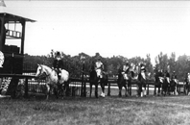
Philosophy
Need to provide a
common set of measures
Measures based on:
  Biomechanics
  Procedures
  Consistent track material
Support research:
  What surfaces are safe?
  When are they unsafe (climate, composition?)
Provide tools & lab support to evaluate materials

Slide 33

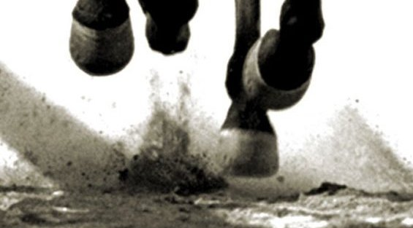
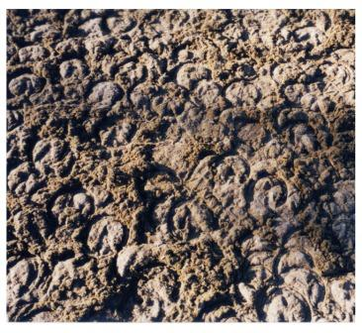
How to Move Forward
All track maintain shear without excess hardness
Multiple answers
  Climate
  Materials
Basic performance tests …consistently performed
Evaluate the results – safety & performance!

Slide 34
The remaining question:
Epidemiology?
It only matters is we help horses and riders

