Slide 1
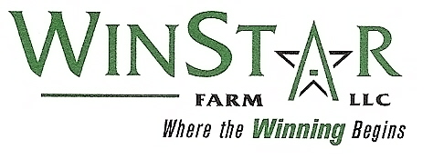
The Detrimental Effects of Toe Grabs Thoroughbred Racehorses at Risk
Presented by Bill Casner
Prepared by Mitch Taylor August 2008
Endorsed by: The Jockey Club, The Grayson-Jockey Club Research Foundation and The Kentucky Horseshoeing School
Kentucky Horseshoeing School

Slide 2
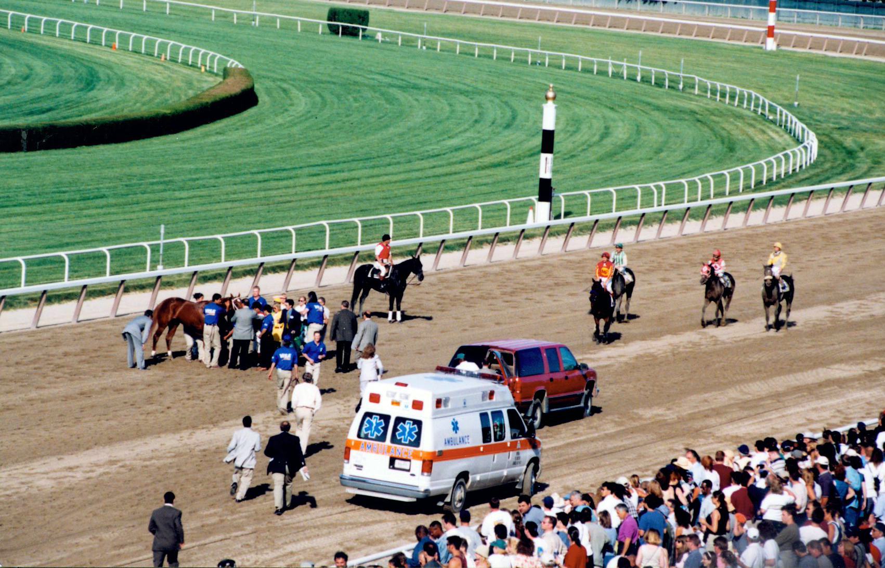
The Problem
Photo by: Z

Slide 3
Documented Research Results
Musculoskeletal injuries have a $1 billion dollar economic impact on the Thoroughbred racehorse industry
Up to 83% of Thoroughbred racehorse deaths can be attributed to an exercise-related injury
Toe grabs have been shown to be a contributing factor in racehorse breakdowns.

Slide 4
Queens plate

Slide 5
Queens plate XT (2mm)

Slide 6
Low toe (4mm)

Slide 7
Regular toe (6mm)

Slide 8
Quarter horse toe (8mm)

Slide 9
Inner rim shoe (6mm grab)

Slide 10
Studies conducted at top research centers show that toe grabs increase the risk of injury
Sources:
2007, Risk factors for proximal sesamoid bone fractures associated with exercise history and horseshoe characteristics in thoroughbred racehorses. Hill, A., Stover, S., et. Al, AJVR, vol 68.
2004, Effects of injury to the suspensory apparatus exercise and horseshoe characteristics on the risk of lateral condylar fracture and suspensory apparatus failure in forelimbs of thoroughbred racehorses. Hill, A. et. al, AJVR, vol 65.
2004, Evaluation of forelimb horseshoe characteristics of thoroughbreds racing on dirt surfaces. Gross, D., Stover, S. et.al, AJVR, vol 66.
2001, Risk factors for and outcomes of non-catastrophic suspensory apparatus injury in thoroughbred racehorses. Hill, A., Stover, S., et. al, JAVMA, vol 218.
2001, Underrun heels and toe grab length as possible risk factors for catastrophic musculoskeletal injuries in Oklahoma racehorses. AAEP, vol 47
1996, Evaluation of horseshoe characteristics and high-speed exercise history as possible risk factors for catastrophic musculoskeletal injury in thoroughbred racehorses. Hernandez, J., et.al, AJVR , vol 66.
1996, Postmortem evaluation of homotypic variation in shoe characteristics of 201 thoroughbred racehorses. Kane, A., Stover, S., et. al, AJVR, vol 57.
1994, Causes of death in racehorses over a 2 year period. Johnson, B. J. et al., Equine Vet. J., vol 26.
1994, Epidemiologic studies of racehorse injuries. Kobluk, C.N., Current Techniques in Equine Surgery and Lameness, 2nd ed., Eds: N.A. White and J.M. Moore, W.B Saunders Co. pp 564-569.

Slide 11
The odds of injury increase with height of toe grab
Low Toes (4mm) Reg toes (6mm)
Fatal musculoskeletal injuries 1.8 x 3.5 x
Suspensory apparatus failure 6.5 x 15.6 x
Cannon bone condylar fracture 7.0 x 17.1 x
1996, Horseshoe characteristics as possible risk factors for fatal musculoskeletal injury of thoroughbred racehorses. Kane, A., Stover, S., et.al, AVJR, vol 57.

Slide 12
The Mechanics of Toe Grabs
How do shoes with toe grabs effect the leg?
They act like a snowplow in the cushion to amplify fetlock and coffin joint hyper-extension under load
They result in a broken-back hoof pastern axis when standing
Clipping heels have catastrophic results

Slide 13
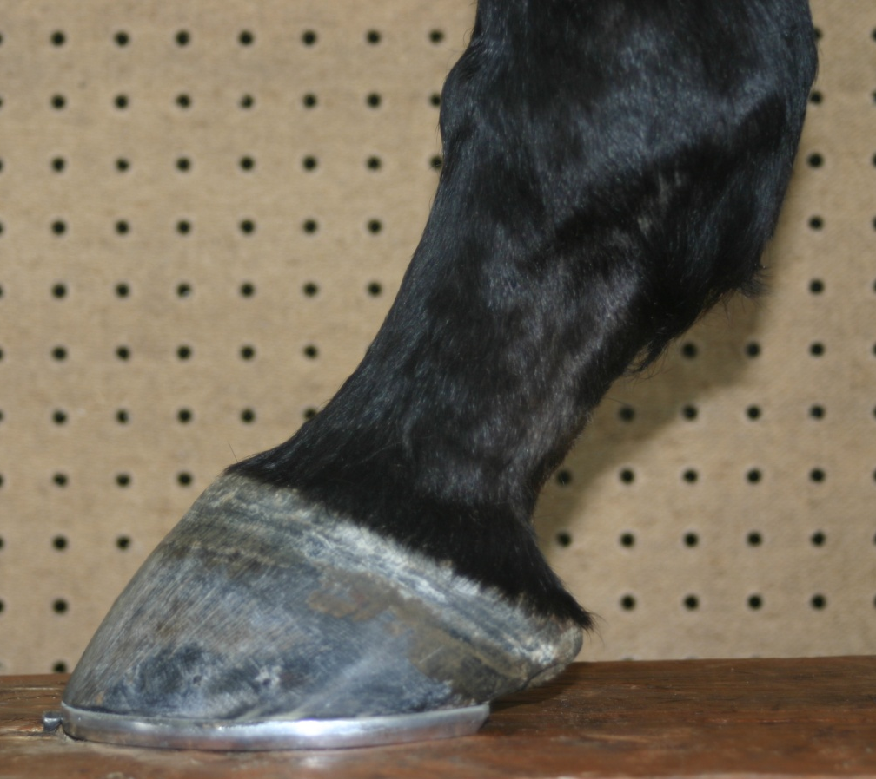
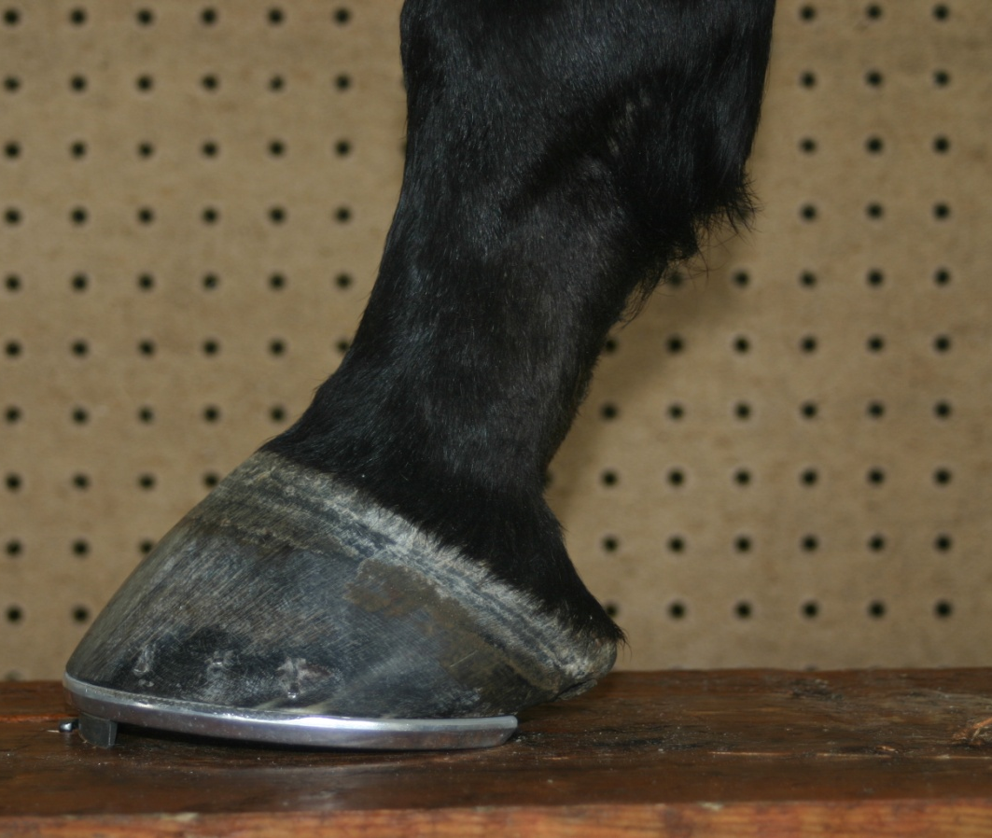
The Effects of a Regular Toe Grab on the Stance Phase of the Stride (While standing & on sloppy track)
Toe grabs cause a broken back hoof pastern axis
6”
6”
5”
5”
300 lbs
300 lbs

Slide 14
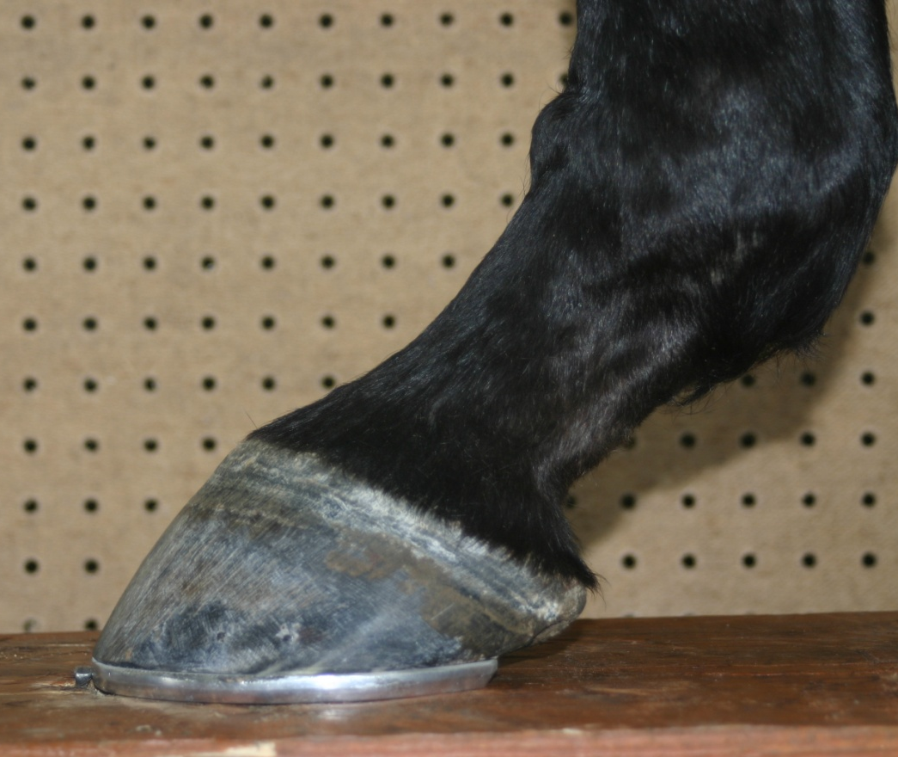
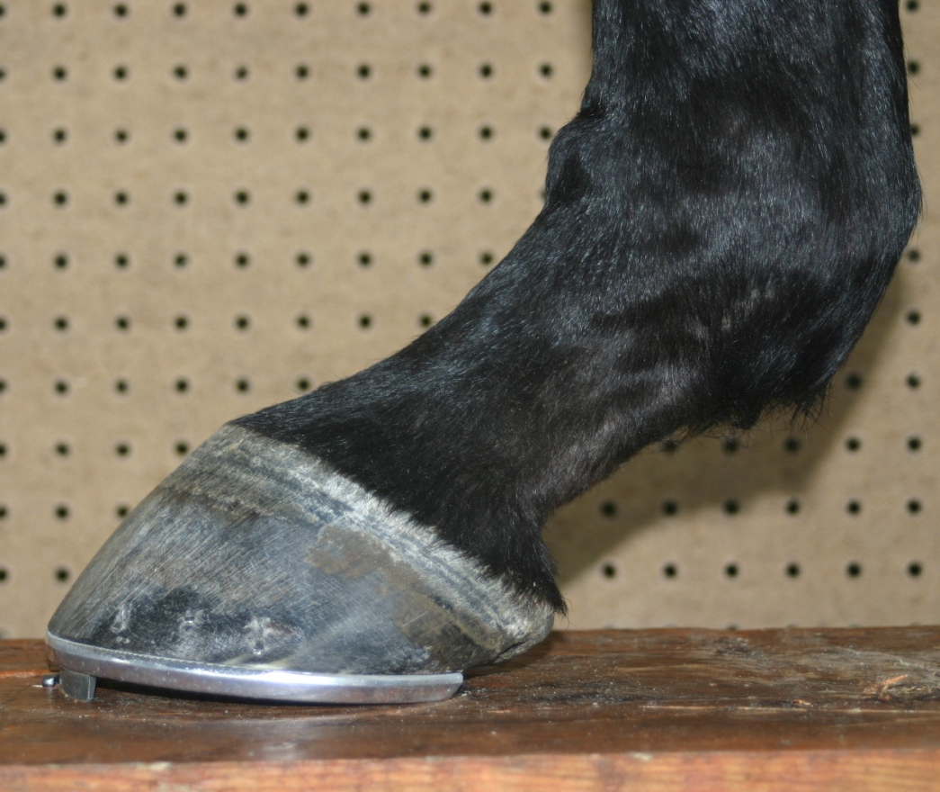
The Effects of a Regular Toe Grab on the Stance Phase of the Stride
The elevation of the toe results in an unnatural and unhealthy loading of the bones of the digit
4”
4”
1200 lbs
3”
3”
1200 lbs

Slide 15
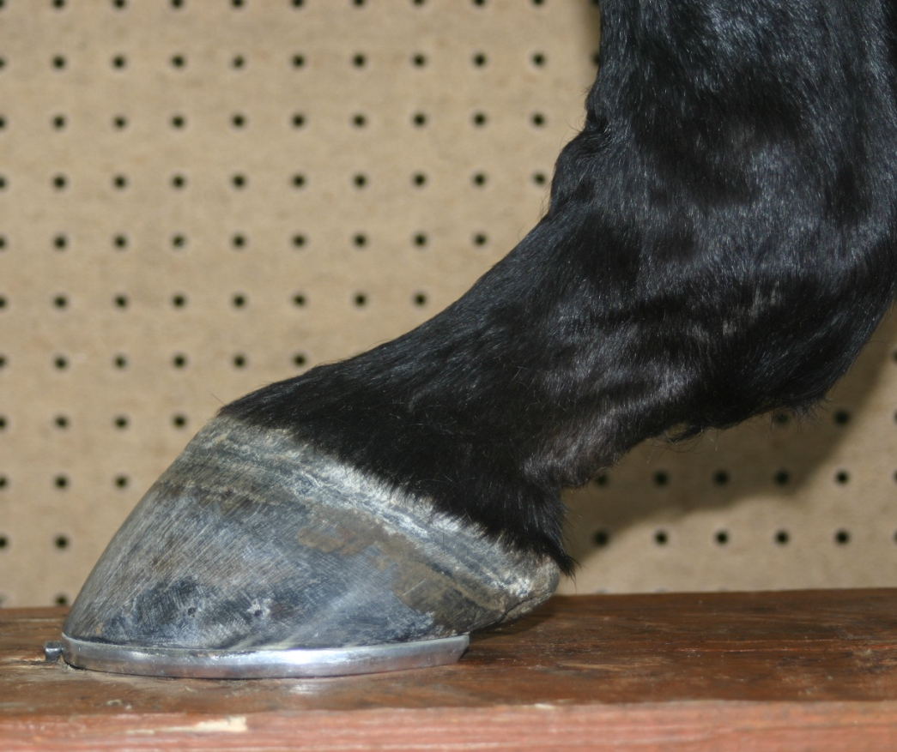
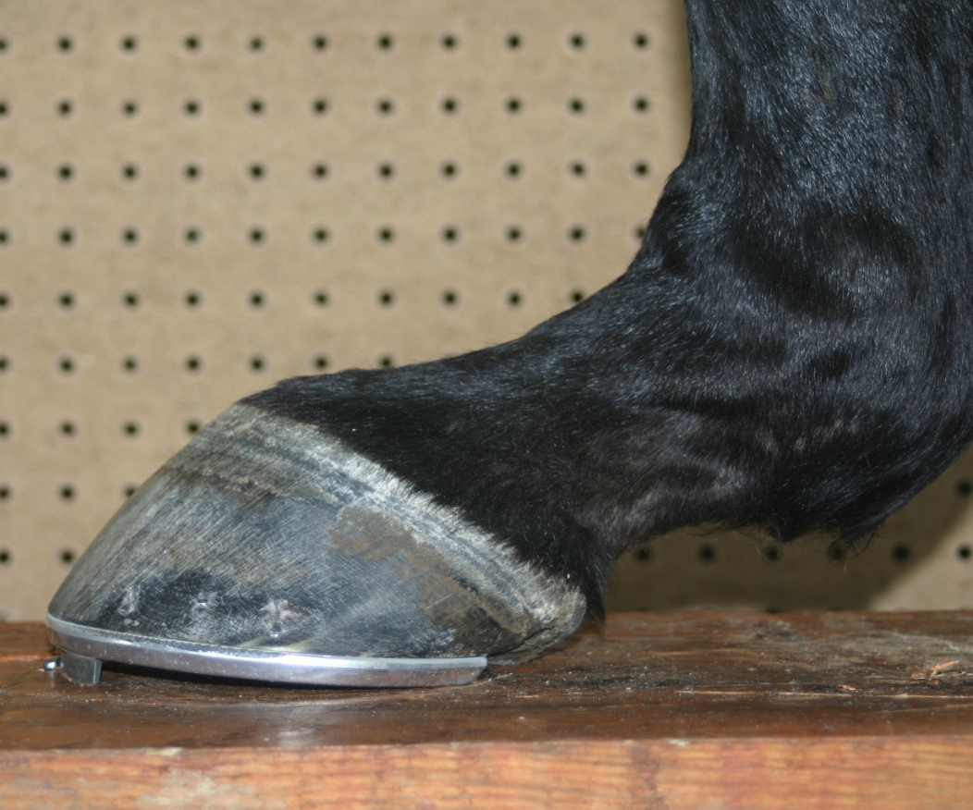
The Effects of a Regular Toe Grab on the Stance Phase of the Stride
The toe grab results in an increased tension on the suspensory apparatus and more compression of the heels
3”
3”
1.5”
1.5”
3000 lbs
3000 lbs

Slide 16
Clipping heels

Slide 17
Close up of toe grabs locking

Slide 18
The Solution
Eliminate the use of toe grabs on front feet
Continue to fund quantifiable research in equine lameness
Develop minimum required standards for farriers
Develop a standardized training curricula for farriers
Education and regulation can help prevent this

Slide 19
Special thanks to:
The Jockey Club, The Grayson-Jockey Club Research Foundation, The Kentucky Horseshoeing School, Keeneland, Churchill Downs, Winstar Farms and to the Welfare and Safety Summit Horseshoeing Task Force for providing the background and support for this presentation.
Kentucky Horseshoeing School

